Slide 2
In the news this week…
SATs tests, GCSEs and A-Level exams have all been cancelled across the UK. Prime Minister, Boris Johnson, has said "exams will not take place as planned in May and June". Pupils whose exams were cancelled due to the coronavirus pandemic will be given grades estimated by their teachers, the government has said.
Would you prefer your teacher to give you a grade or take a test?
Learn more about this week’s story here.
Watch this week’s useful video here.

Slide 3
How does it make me feel?
sad | angry | happy | confused | excited | worried | shocked | afraid
despondent disconsolate dismal doleful downhearted forlorn gloomy melancholic miserable woeful wretched | aggrieved annoyed discontented disgruntled distressed exasperated frustrated indignant offended outraged resentful vexed | beaming buoyant cheery contented delighted enraptured gleeful glowing joyful | addled baffled bemused bewildered disorientated indistinct muddled mystified perplexed puzzled | animated elevated enlivened enthusiastic exhilarated exuberant thrilled | agitated anxious apprehensive concerned disquieted distraught distressed disturbed fretful perturbed troubled uneasy | astonished astounded disconcerted distressed dumbfounded horrified staggered startled stunned surprised | alarmed apprehensive daunted fearful frantic horrified petrified terrified

Slide 4
Assembly Resource
Read the different opinions about school exams and tests. Do you agree with any?
I am due to sit my final school exams next year.
I’m quite worried as when I get nervous, I sometimes forget things. I wish my teacher could give me my final grade as I feel they know what I’m capable of and how hard I’ve worked.
Jake, Age 17
Source: BBC News

Slide 5
Assembly Resource
Read the different opinions about school exams and tests. Do you agree with any?
As a teacher, I think exams have an important part to play. I wouldn’t want the responsibility of deciding my pupils’ grade or marks.
Some pupils work really hard before the test and do much better than I thought they would!
Max, Age 32
Source: BBC News

Slide 6
Assembly Resource
Read the different opinions about school exams and tests. Do you agree with any?
I think tests and exams are an important part of life. There’s no other fair way to see if you’ve learned something. I think they are an important part of growing up as you are tested on different things.
Annabelle, Age 62
Source: BBC News

Slide 7
Assembly Resource
Read the different opinions about school exams and tests. Do you agree with any?
I get very nervous about tests before I take them. Sometimes I make silly mistakes.
We do weekly spellings and times tables tests at school. I’m always glad when they are over but I do think they help me to learn things.
Leanne, Age 9
Source: BBC News

Slide 8
Assembly Resource
Read the different opinions about school exams and tests. Do you agree with any?
I absolutely love taking part in tests!
When I’ve worked really hard, it’s a great chance to show everyone what I’ve learned!
Ava, Age 12
Source: BBC News

Slide 9
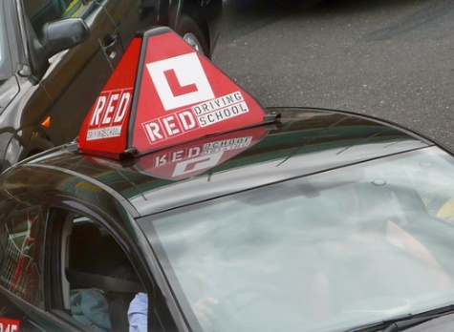
Resource 1
Look at the resource below, which shows examples of different tests taken by people.
Have you ever taken any of these tests? Can you think of any other tests?
When you reach the age of 17, you can learn to drive a car on the road. Before you can do this on your own, you have to take a driving test.
Credit: David
Source: Shazron

Slide 10
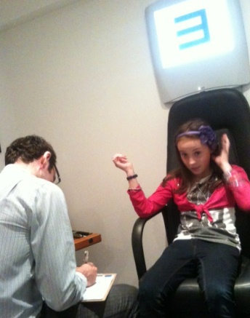
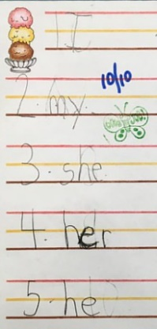
Resource 1
Look at the resource below, which shows examples of different tests taken by people.
Sometimes you might have a test in school like a spelling test, a maths test or you might even have heard of SATs.
Some people have sight tests to test their eyesight and find out if they need glasses or not.
Credit: Dave Haygarth
Credit: rory and yoojin
Source: Shazron

Slide 11
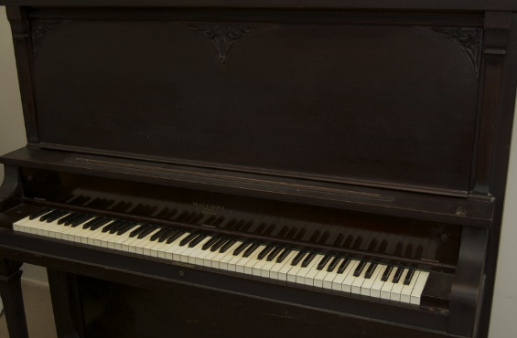
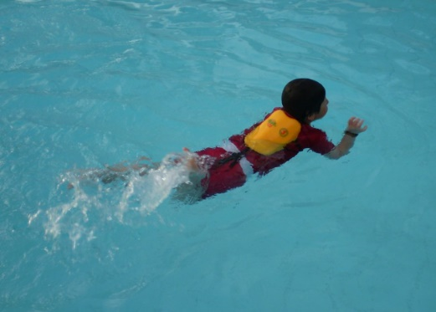
Resource 1
Look at the resource below, which shows examples of different tests taken by people.
Credit: Ben Askins
Credit: ximena
You can take a test to see how far you can swim. You can earn a badge or a certificate!
Some people choose to learn a musical instrument. You can take a test or exam.

Slide 12
Resource 1
Look at the resource below, which shows examples of different tests taken by people.
Do you have a badge or certificate?
Source: Shazron

Slide 13
Resource 2
Look at the resource below, which gives examples of alternatives to a written test.
Written tests
You may have taken part in a written test. This could be to find out what you know in different subject areas such as spelling, maths, reading.
Tests are often completed in silence and by ourselves. Sometimes there is a time limit on them.
What other ways could be used to find out what we know?

Slide 14
Resource 2
Look at the resource below, which gives examples of alternatives to a written test.
Draw a picture, design a poster or create a sketch to show you understand something.
Look at other work we produce e.g. check our spelling during a writing lesson.
Answer questions orally rather than writing them down.

Slide 15
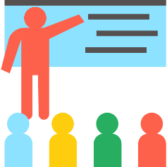
Resource 2
Look at the resource below, which gives examples of alternatives to a written test.
You may be given a task to complete and somebody may just observe you doing it.
Perform or present your spellings, times tables or the subject you will be tested on instead! It could be sung or rapped.
Online tests or quizzes.

Slide 16
Resource 2
Look at the resource below, which gives examples of alternatives to a written test.
Do you think many of these alternatives happen in schools?

Slide 17
Reflection
As we go through life, it’s likely we will experience lots of different tests. These could be for playing the piano, swimming, maths or driving. Some of us may enjoy completing tests, others not as much. We can prepare ourselves though, which can make it easier for us.

Slide 19
This Week’s Useful Vocabulary
Cancelled – when you have decided or announced that a planned event will not take place.
Estimate – make an approximate judgement, calculation or quantity.
Experience – when you experience something, you encounter or undergo it. It happens to you.
Pandemic – an outbreak of disease that has spread over several countries or the world.
Reduce – make something smaller or less.

