Slide 1
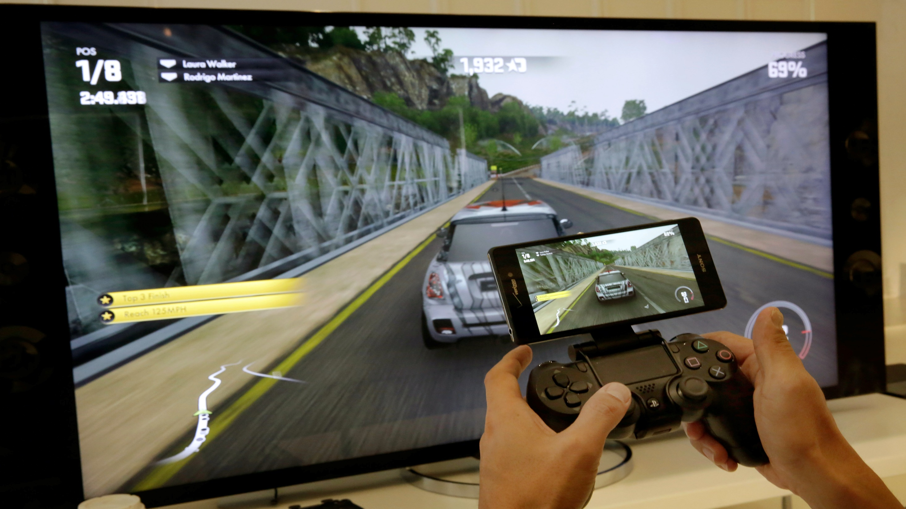

Slide 2
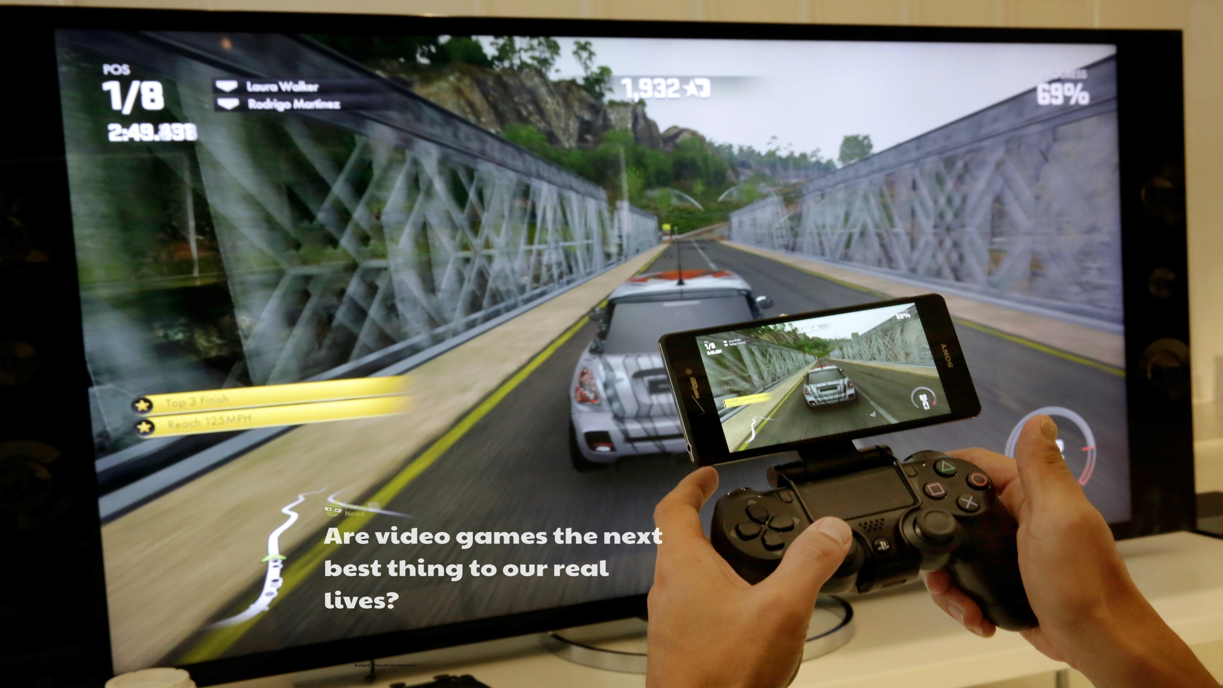

Slide 3
In the news this week…
The World Health Organisation (WHO) have partnered with technology companies around the world campaigning to show how gaming can help fight coronavirus and 'save lives'. The WHO and computer game producers have come together to work on the #PlayApartTogether campaign which aims to spread the importance of WHO guidelines, that will slow the spread of COVID-19, including staying inside, to the global audience of the gaming industry.
Do you have a favourite computer game?
Learn more about this week’s story here.
Watch this week’s useful video here.

Slide 4
How does it make me feel?
sad | angry | happy | confused | excited | worried | shocked | afraid
despondent disconsolate dismal doleful downhearted forlorn gloomy melancholic miserable woeful wretched | aggrieved annoyed discontented disgruntled distressed exasperated frustrated indignant offended outraged resentful vexed | beaming buoyant cheery contented delighted enraptured gleeful glowing joyful | addled baffled bemused bewildered disorientated indistinct muddled mystified perplexed puzzled | animated elevated enlivened enthusiastic exhilarated exuberant thrilled | agitated anxious apprehensive concerned disquieted distraught distressed disturbed fretful perturbed troubled uneasy | astonished astounded disconcerted distressed dumbfounded horrified staggered startled stunned surprised | alarmed apprehensive daunted fearful frantic horrified petrified terrified

Slide 5
Assembly Resource
Read through the information below, which looks at the #PlayApartTogether campaign. Do you think it is a good idea? What other ideas or advice would you give to help keep people busy whilst they are spending a lot of their time inside?
What is the #PlayApartTogether campaign?
The campaign encourages people all around the world to play video games together! People are able to interact with others and have fun whilst staying inside.
Source: BBC News

Slide 6
Assembly Resource
Read through the information below, which looks at the #PlayApartTogether campaign. Do you think it is a good idea? What other ideas or advice would you give to help keep people busy whilst they are spending a lot of their time inside?
Games industry companies have a global audience - we encourage all to #PlayApartTogether.
Through this unifying hashtag, companies will encourage conversation within their games and on social media. I thank the games industry for stepping up to help bring an end to the COVID-19 pandemic.
Ray Chambers, The World Health Organisation’s Ambassador for Global Strategy
Source: BBC News

Slide 7
Assembly Resource
Read through the information below, which looks at the #PlayApartTogether campaign. Do you think it is a good idea? What other ideas or advice would you give to help keep people busy whilst they are spending a lot of their time inside?
Alongside video games, here are some other games you can play inside (some of these you can play virtually with friends too!):
Snakes and ladders or other board games
Card games
Hide-and-seek
Simon Says
Pictionary
I Spy
Indoor treasure hunt
Can you think of anymore?
Source: BBC News

Slide 8
Resource 1
Look at the resource below, which explains what a video game is and shares examples of when some children have played them.
A video game is a game where a player uses controls or buttons to control moving pictures on a screen. This could be a computer, television, mobile phone, tablet, laptop etc. Sometimes we call them computer games.
Source: Shazron

Slide 9
Resource 1
Look at the resource below, which explains what a video game is and shares examples of when some children have played them.
I play a game on my dad’s mobile phone. You have to move a snake around the screen making sure you don’t bang into any of the other snakes!
Source: Marco Verch
Lily
Source: Shazron

Slide 10
Resource 1
Look at the resource below, which explains what a video game is and shares examples of when some children have played them.
I use my laptop to play lots of games to help me with my times tables and mental maths.
Source: Richard Masoner
Steffan

Slide 11
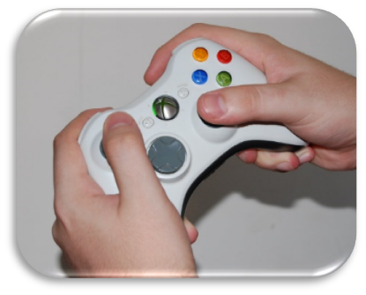
Resource 1
Look at the resource below, which explains what a video game is and shares examples of when some children have played them.
I have an Xbox 360. I really enjoy playing a football game and I can join up and play with my friends too. We can chat whilst we play.
Source: Shaun Greiner
Tabinda

Slide 12
Resource 1
Look at the resource below, which explains what a video game is and shares examples of when some children have played them.
Have you ever played a video game before? What was it? What did you play it on? Who did you play it with?
Source: Shazron

Slide 13
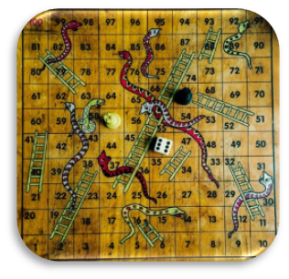
Resource 2
Look at the resource below which shows examples of some of the different types of game we might play.
Have you ever played any of these games before? Can you think of any other examples?
Board games
Snakes and Ladders
Monopoly
Guess Who?
Source: Leonard J Matthews

Slide 14
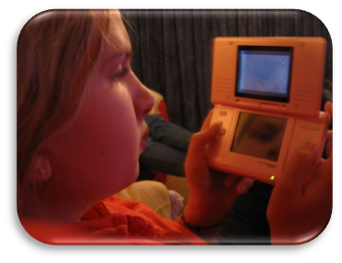
Resource 2
Look at the resource below which shows examples of some of the different types of game we might play.
Sports games
Netball
Cricket
Tennis
Croquet
Video games
Minecraft
Slither.io
Mario
Source: Hans Splinter
Source: Owen Lucas

Slide 15
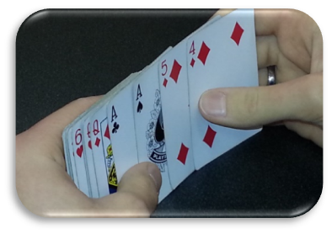
Resource 2
Look at the resource below which shows examples of some of the different types of game we might play.
Source: kiwi huang
Card games
Uno
Pitt
Rummy
Imaginary/role-play games
Cops and robbers
Superheroes
Space travellers
Tag games
Hide and seek
Blockie
Stuck in the mud
Source: Steven & Courtney Johnson & Horwitz
Source: Vivid Image

Slide 16
Reflection
There are lots of different ways we can have fun inside! The World Health Organisation have used computer games as one example to socialise with our friends ‘virtually’ and to help keep our minds busy!

Slide 18
This Week’s Useful Vocabulary
Campaign – an organised and planned set of actions, carried out over a period of time, to achieve a goal.
Guidelines – official advice about how to do something.
Industry – a particular industry is all of the people and activities involved in making a product or providing a service.
Realistic – representing something in a way that is accurate and true to life.
Socialise – to take part in social activities; to mix with others.

